Slide 1
High-throughput Online Hash Table on FPGA
Author : Da Tong, Shijie Zhou, Viktor K. Prasanna
Publisher : 2015 IEEE International Parallel and Distributed Processing Symposium Workshops

Slide 2
present a pipelined architecture for high throughput online hash table on FPGA. The proposed architecture supports search, insert,and delete operations at line rate for the massive hash table which is stored in off-chip memory.

Slide 3
A pipelined architecture for online hash table.
An application speciﬁc data forwarding unit.
Two hash table access schemes.
A high throughput multi-functional pipelined architecture.

Slide 4
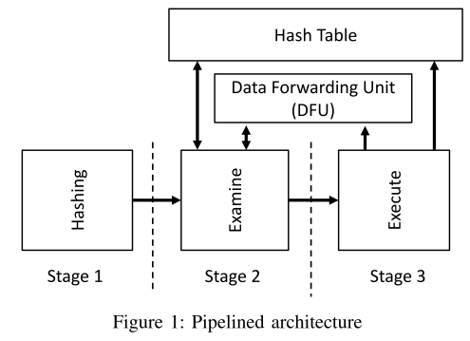
Overall Architecture
Stage 1(Hashing): The hash entry is computed
Stage 2(Examine): The hash slots of the hash entry are retrieved and examined.
Stage 3(Execute): The operation is performed according to the examination result from Stage 2.

Slide 5
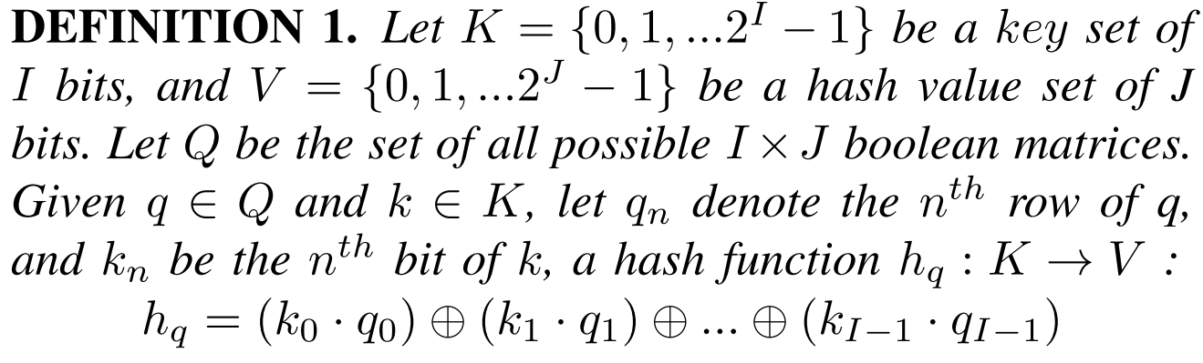
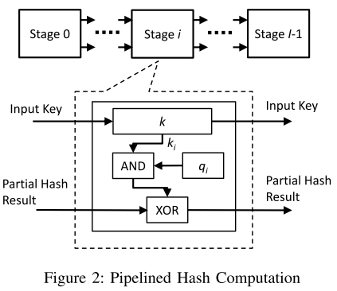
Hash Function

Slide 6
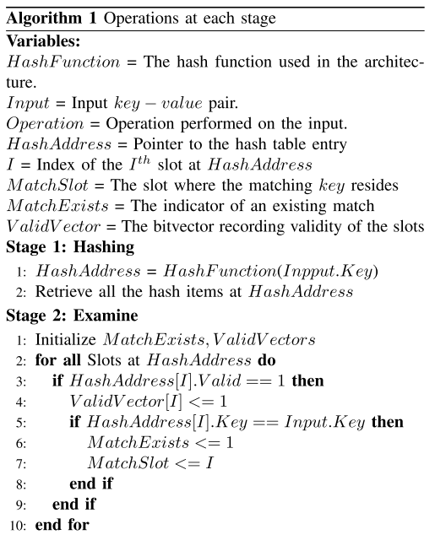
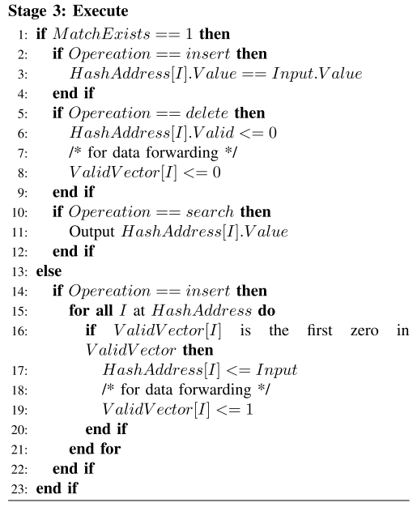

Slide 7
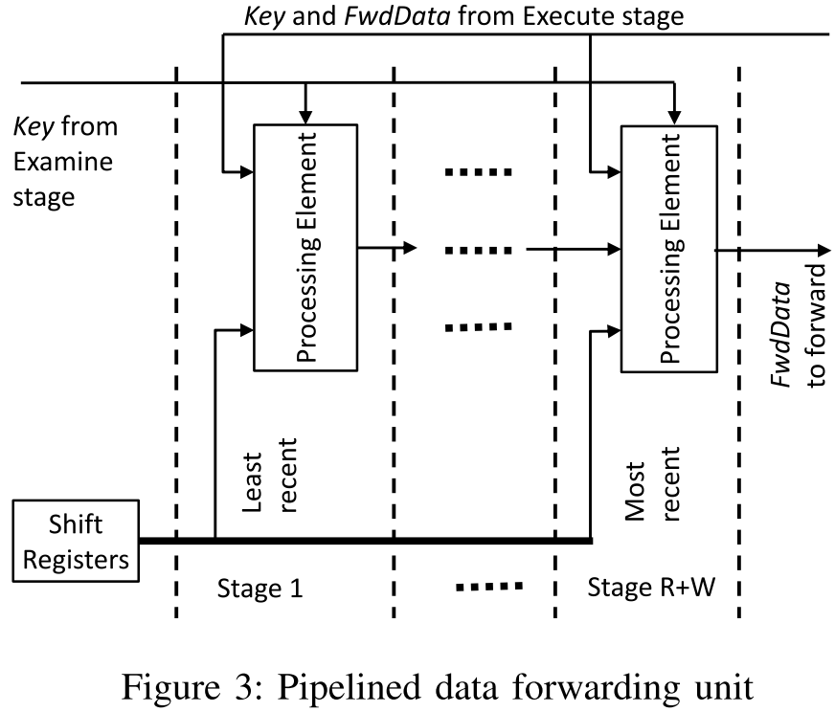
• One pair of key and FwdData from the shift register.
• The key and FwdData at the Execute stage
• The key and FwdData from the previous stage

Slide 8
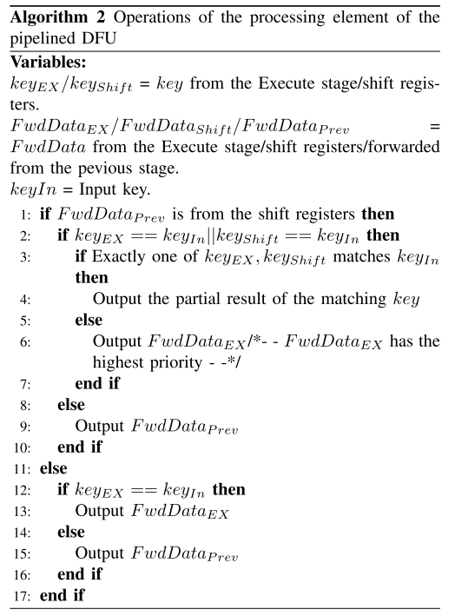

Slide 9
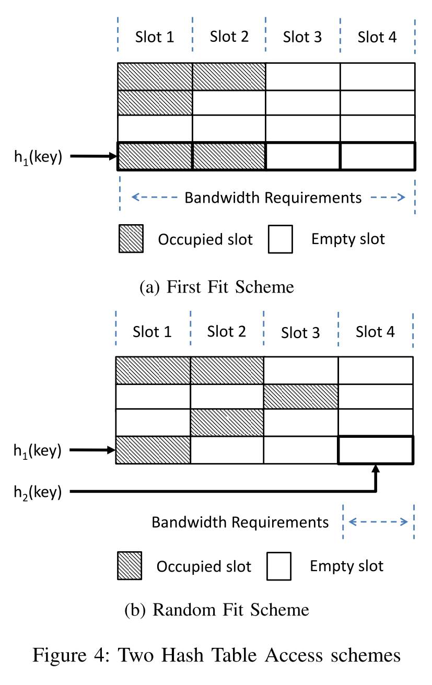
The First fit scheme assigns each hash entry multiple slots to reduce the hash collision rate
The Random fit scheme has a higher hash collision rate but a lower off-chip memory bandwidth requirement than the ﬁrst scheme.

Slide 10
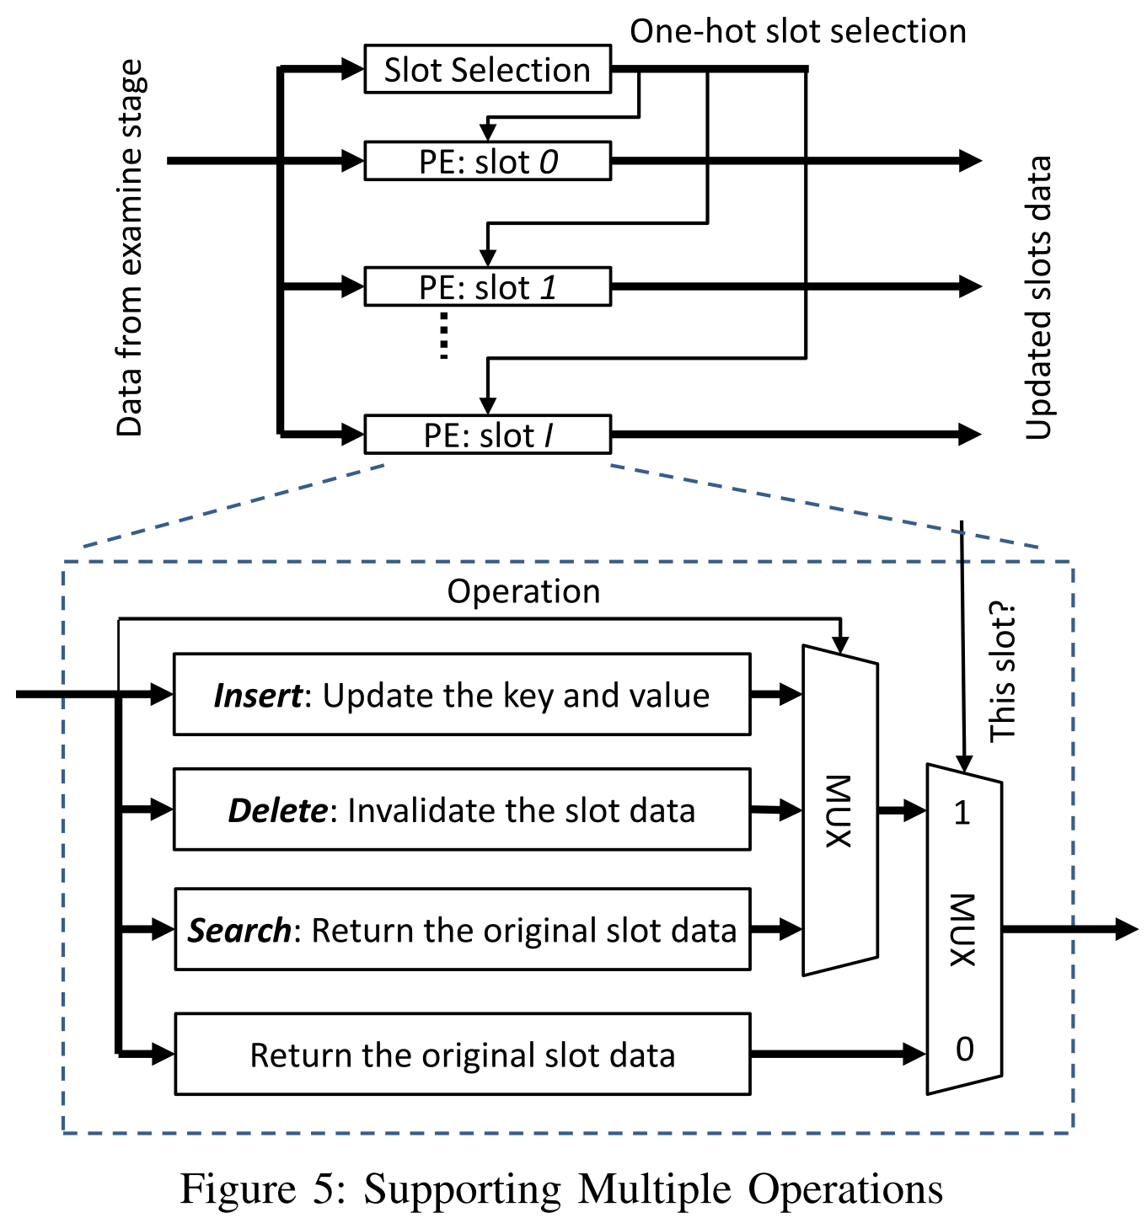

Slide 11
Our target device is Xilinx Virtex 7 XC7VX1140T with -2 speed grade.
All reported results are post place and route results using Xilinx Vivado 2014.3.
use the minimum IP packet size, 40 bytes.

Slide 12
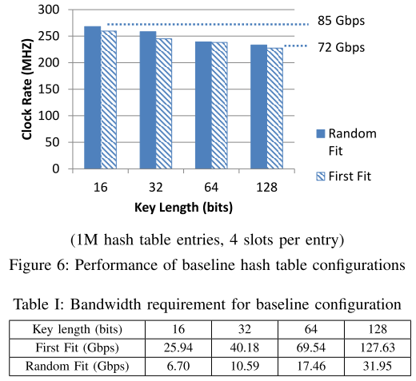

Slide 13
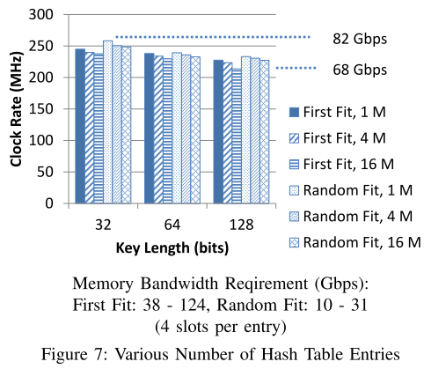

Slide 14
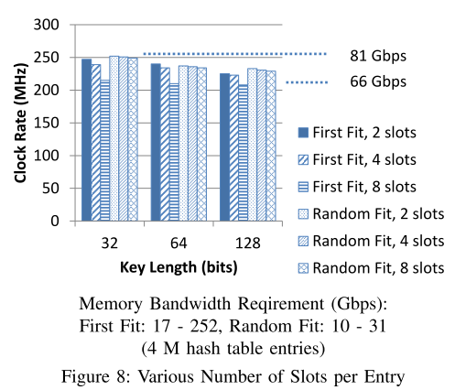

Slide 15
